Slide 1

Convolution Processing Unit
Featuring Adaptive Precision using Dynamic Reconfiguration
WF-IoT 2021 Paper
David Cain, Omar Eldash, Kasem Khalil, Magdy Bayoumi
Presented by David Cain

Slide 2
Overview
Introduction
Computer Vision
Traditional IoT CNN Models
Hardware Accelerator Types
Reconfigurable Hardware
Dynamic Partial Reconfiguration
Related Work
Proposed Convolution Processing Element
Hardware Implementation & Comparisons
Conclusions
Q&A
1

Slide 3

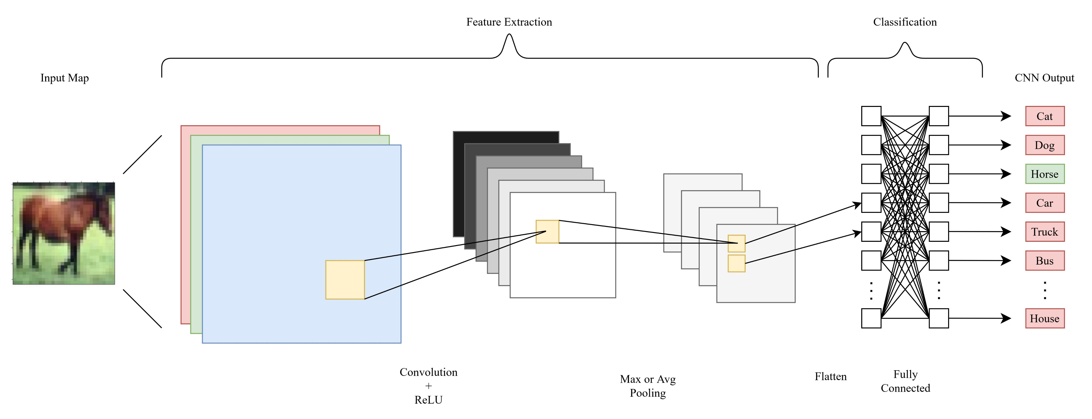
Computer vision is a field which aims to develop models for computers to understand and interpret image data
Unique edge devices with image and video data are being created for these applications in mind
The CNNs used are often complex and too computationally bulky for IoT edge devices
Computer Vision
2

Slide 4
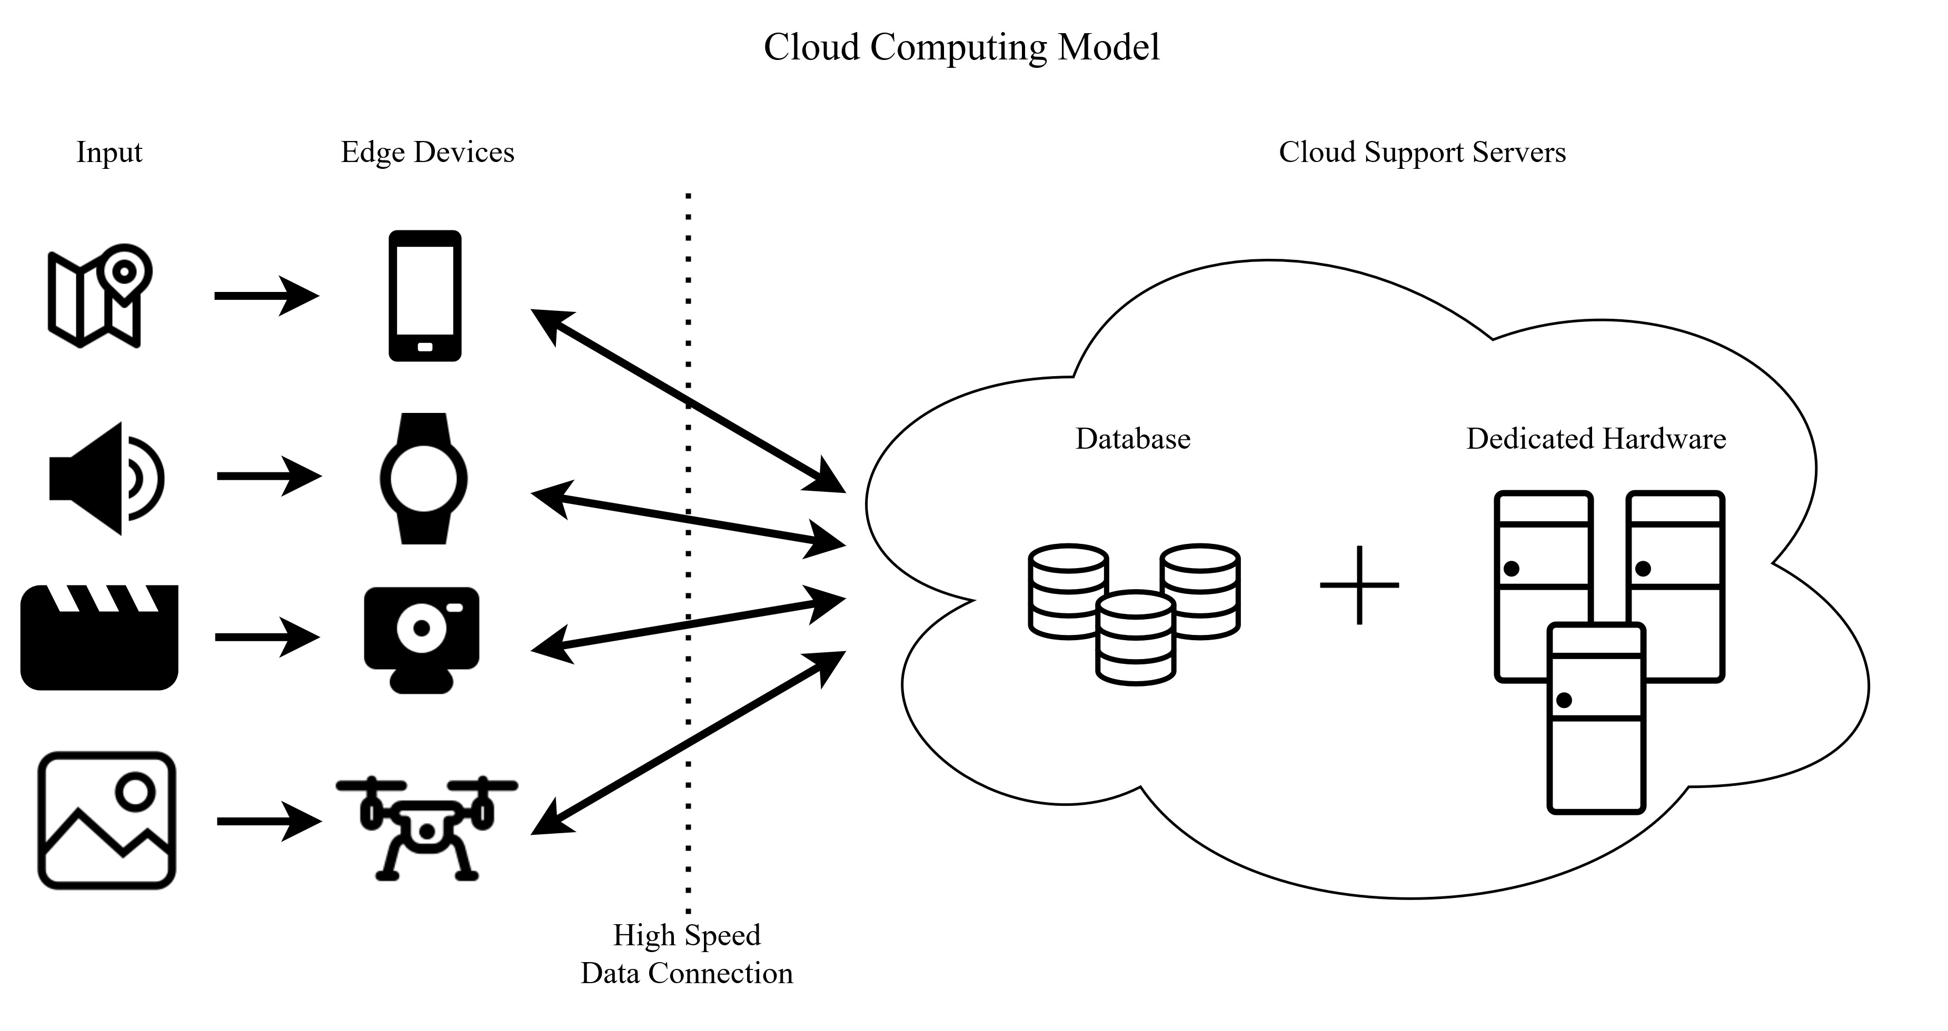
With traditional cloud computing models, edge devices are “dumb” data aggregators
- Zombie device
Cloud servers perform CNN processes
Dedicated server hardware has much greater processing capabilities and relaxed power constraints compared to edge devices
High connectivity required…
How to get these processes local to the edge device?
Traditional IoT CNN Models
3

Slide 5
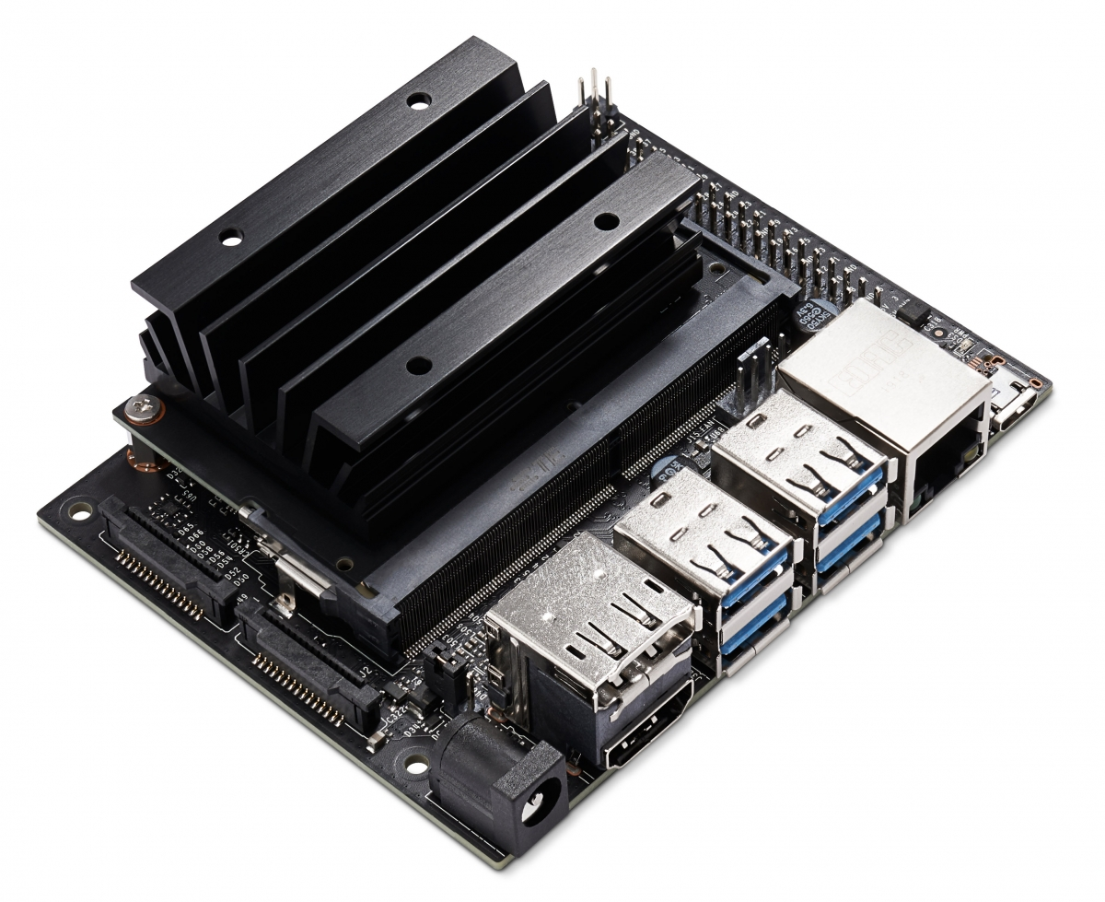
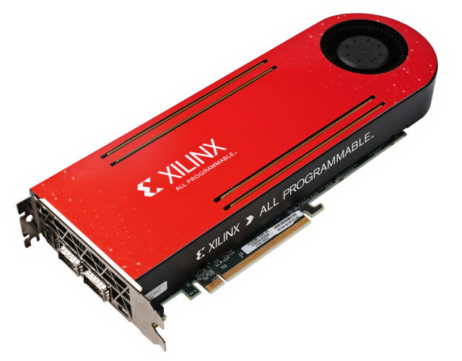
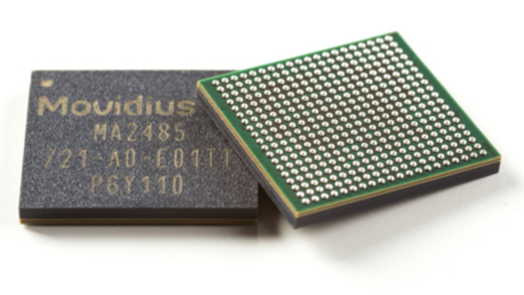
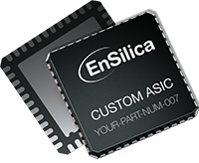
Graphics Processing Unit
(GPU)
Field Programmable Gate Array
(FPGA)
– ex. nvidia Jetson Nano
– NVIDIA JetPack SDK, TensorFlow, PyTorch
– ex. Xilinx Virtex UltraScale+
– Verilog, VHDL, HDL
Vision Processing Unit
(VPU)
Application-Specific Integrated Circuit
(ASIC)
– ex. Intel Movidius Myriad X
– Propriety Intel MDK
– Verilog, VHDL, HDL
Hardware Accelerator Types
4

Slide 6
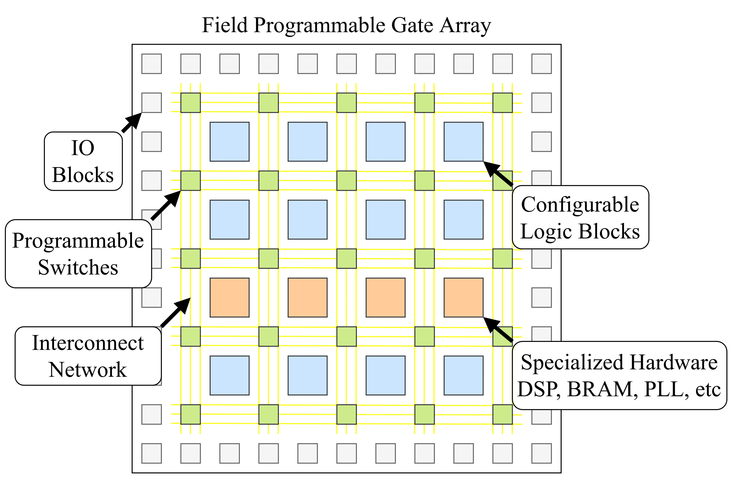
FPGAs are classified as reconfigurable hardware by changing behavior or functionality at the hardware logic level
Here, FPGAs are being investigated for hardware accelerating the CNN process at the edge devices
Low development overhead
Rapid Prototyping
Application Specific Processors
FPGAs offer Dynamic Partial Reconfiguration (DPR)
Reconfigurable Hardware
5

Slide 7
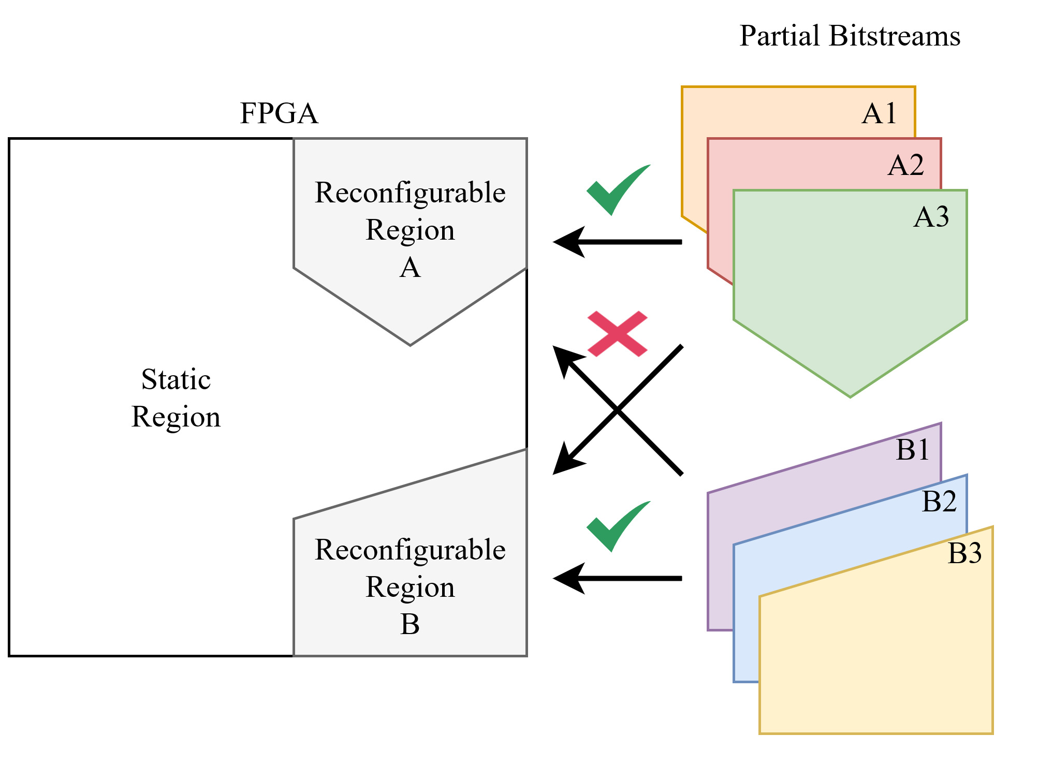
DPR allows the device to partially reconfigure while the rest of the system remains unchanged
Modern DPR design flows use reconfigurable regions with partition definitions to be loaded after full configuration
DPR can minimize system downtime as only individual blocks of the design can be updated
Dynamic Partial Reconfiguration
6

Slide 8
Related Work
Introduction
Computer Vision
Traditional IoT CNN Models
Hardware Accelerator Types
Reconfigurable Hardware
Dynamic Partial Reconfiguration
Related Work
Proposed Convolution Processing Element
Hardware Implementation & Comparisons
Conclusions
Q&A
7

Slide 9
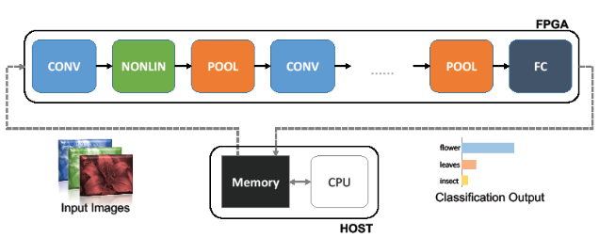
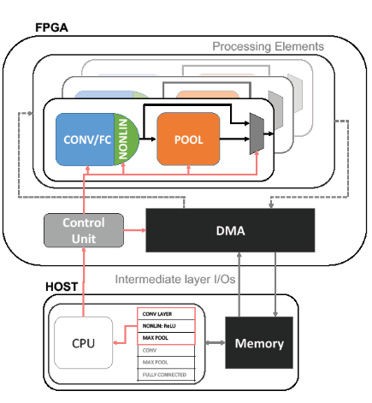
Deploying CNN Models on FPGA
FINN is developed by a Xilinx research group and specializes in low latency architectures
- Streaming Architecture
- Modeled with HLS
FINN Ref: https://xilinx.github.io/finn/about.html
DNNWeaver is an open-source framework that employs groups universal processing elements and a state machine to assign data to one layer of the CNN at a time
- Single Computation Engine
- Modeled with Caffe
DNNWeaver Reg: http://dnnweaver.org/
Ref: Christos Bouganis, “Tool-flows for mapping CNNs into FPGAs: Trends and Challenges”
Related Work
8

Slide 10
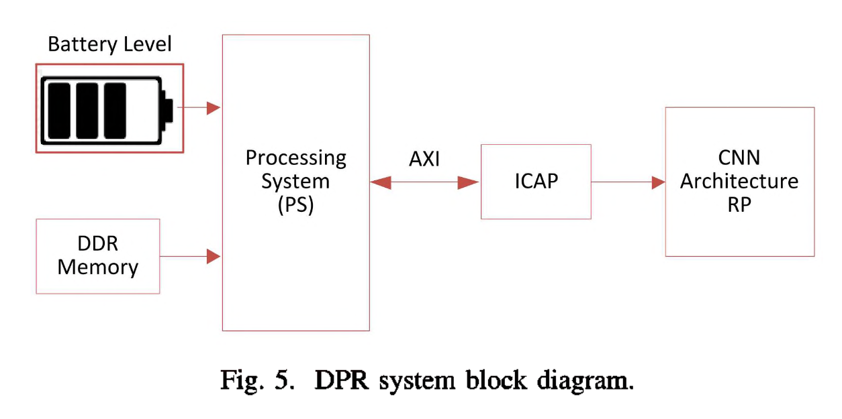
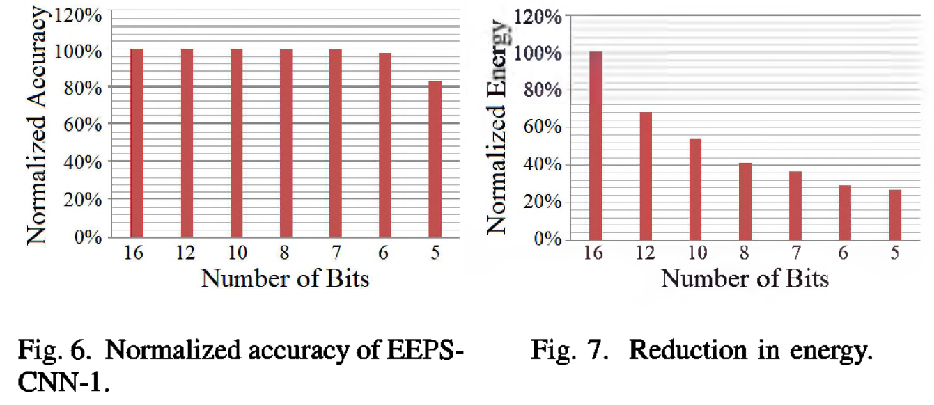
DPR Input Trigger
An Energy Adaptive CNN using DPR
Reconfigurable Region
Ref: E. Youssef, H. A. Elsemary, M. A. El-Moursy, A. Khattab and H. Mostafa, "Energy Adaptive Convolution Neural Network Using Dynamic Partial Reconfiguration," (2020).
Youssef et. al developed an MNIST CNN architecture supporting DPR for reducing processing bit precision
This reconfiguration decreased dynamic power consumption along with model accuracy
The energy consumption of this model at 16-bit processing was shown to be 11.25μJ per image
When configured to 5-bit processing, 3.02 μJ per image while retaining 81.74% accuracy
This model utilizes DPR for configuring the full CNN pipeline rather than by layer/PE
Related Work
9

Slide 11
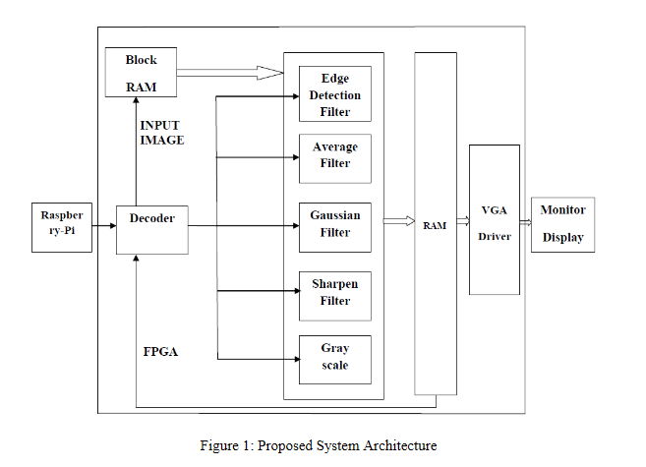
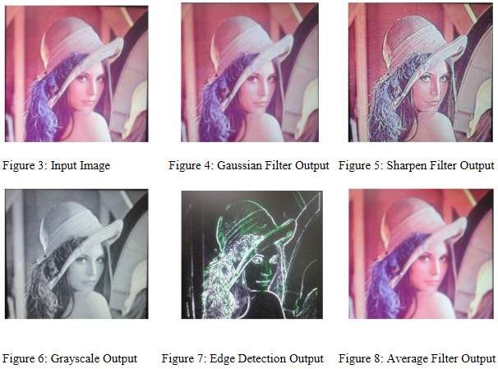
Convolution Processor Using Parallel Pipeline
Rupani et. al present a convolution processing model which utilizes parallel data paths for handling flexible requirements of CNN
Using this method means when one filter is selected, remaining hardware is idle and unavailable for use
Ref: Rupani, Ajay & Whig, Pawan & Sujediya, Gajendra & Vyas, Piyush. “Hardware Implementation of IoT-Based Image Processing Filters,” (2018).
Related Work
10

Slide 12
Proposed Convolution Processing Element
Introduction
Computer Vision
Traditional IoT CNN Models
Hardware Accelerator Types
Reconfigurable Hardware
Dynamic Partial Reconfiguration
Related Work
Proposed Convolution Processing Element
Hardware Implementation & Comparisons
Conclusions
Q&A
11

Slide 13
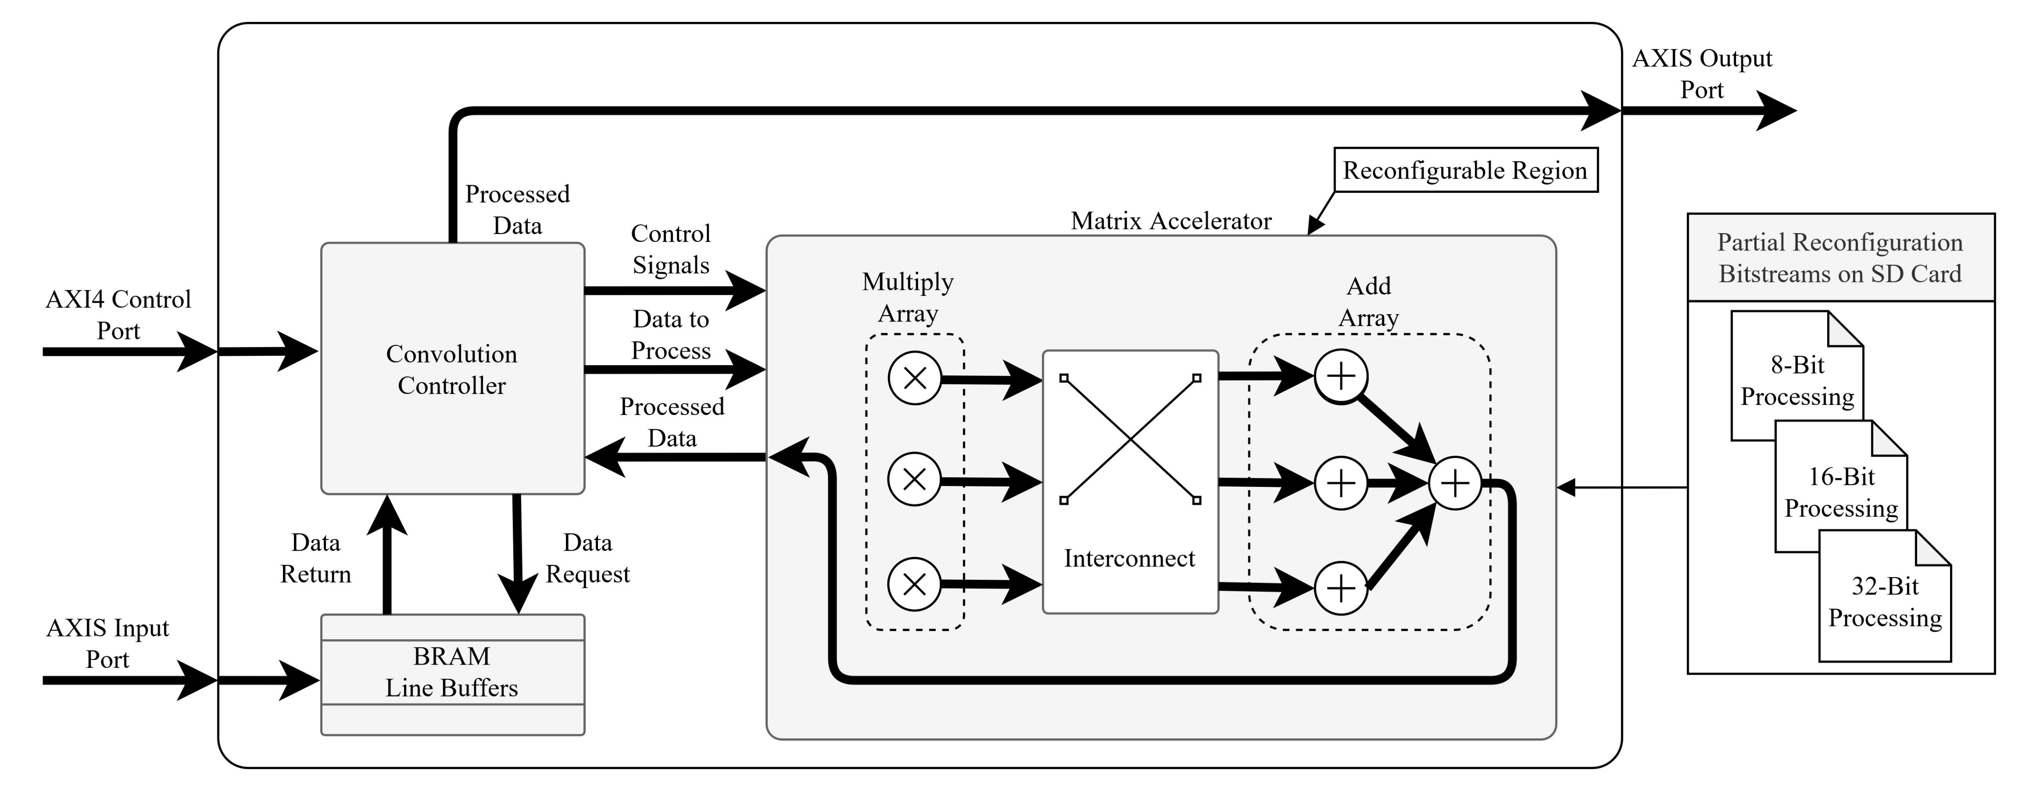
CPE features a convolution controller, line buffers, and matrix accelerator
Proposed Convolution Processing Element
12

Slide 14
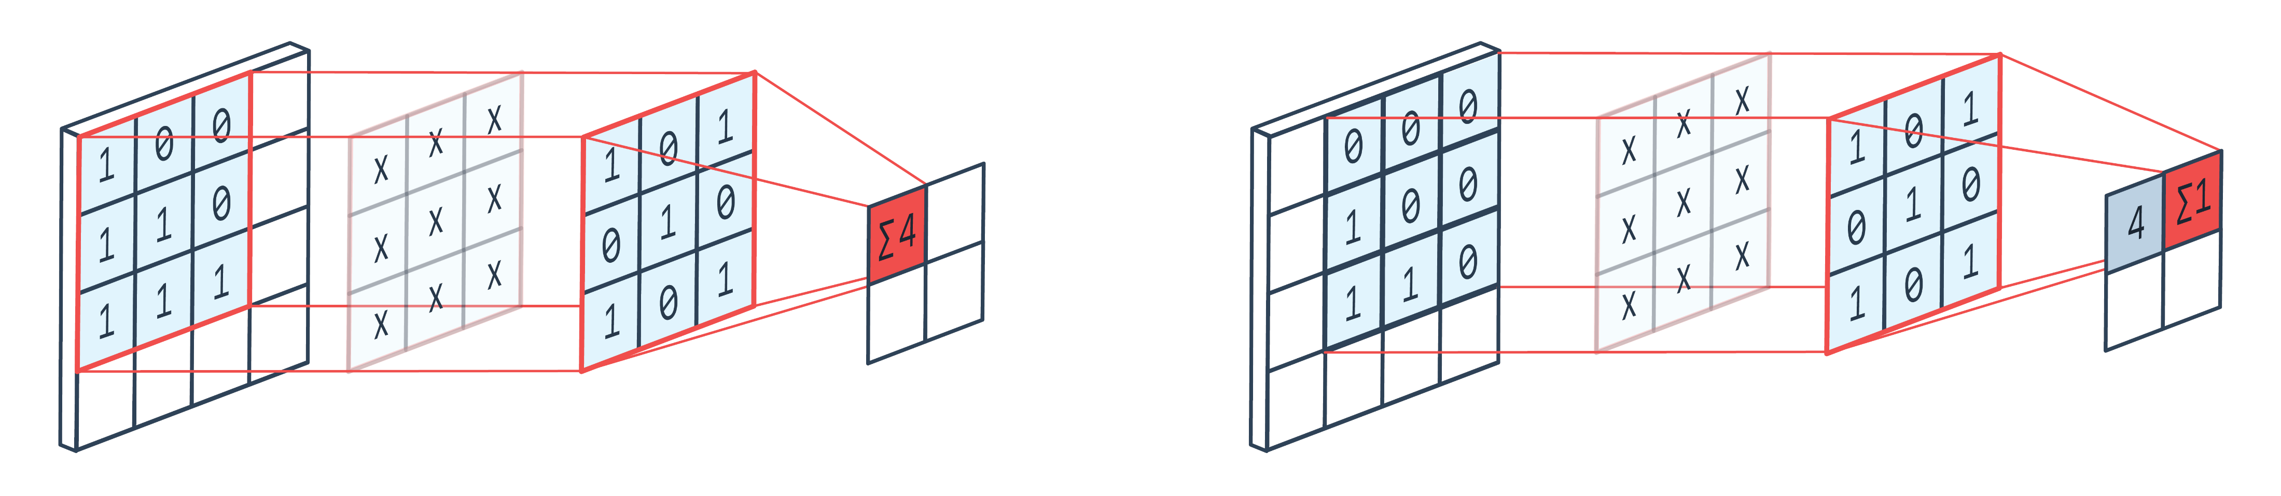
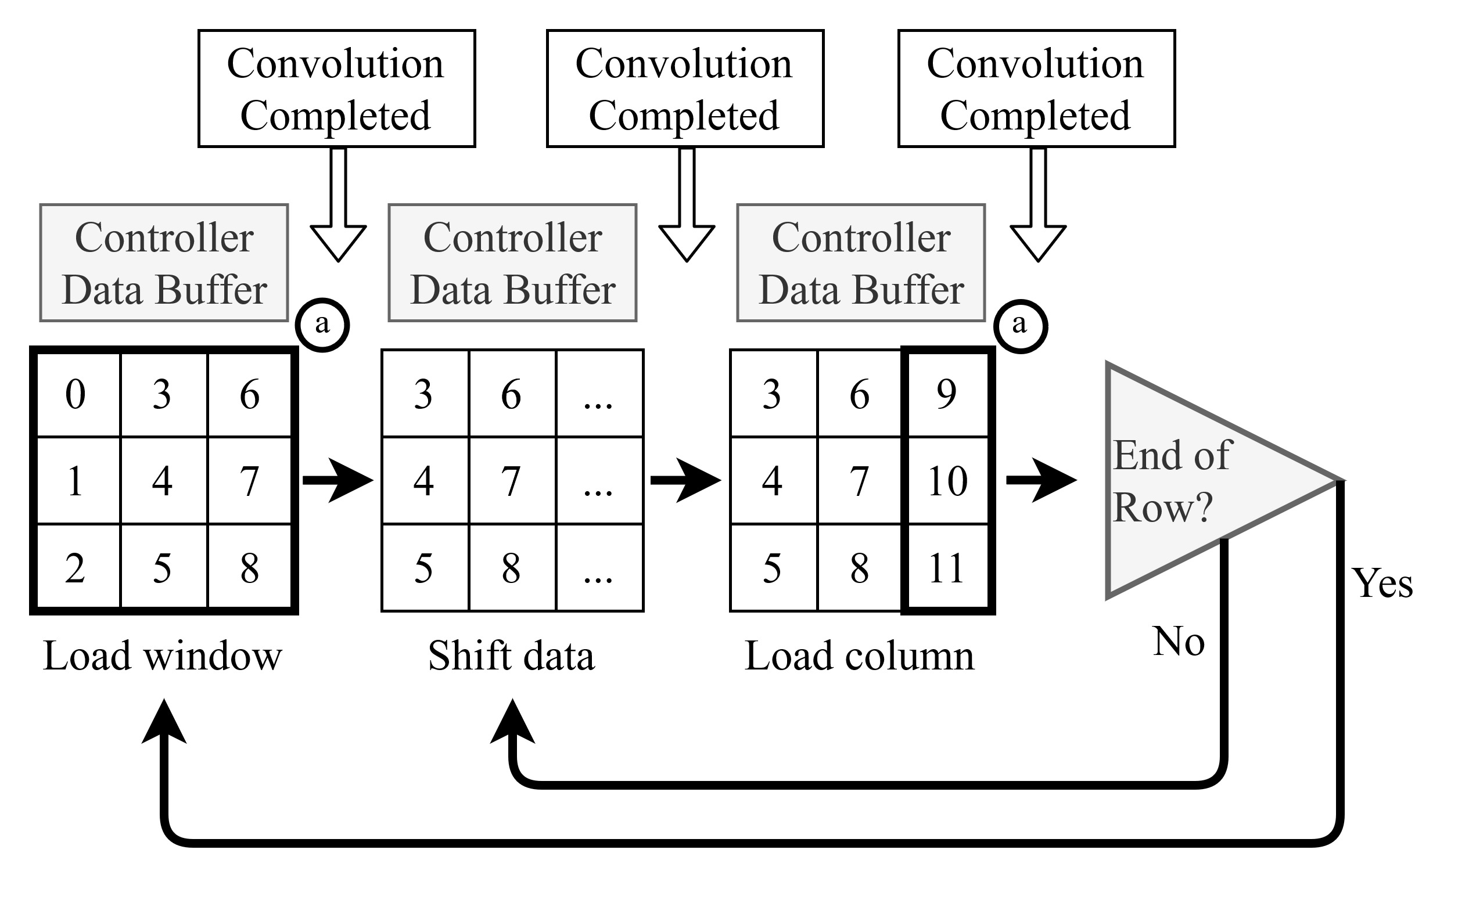
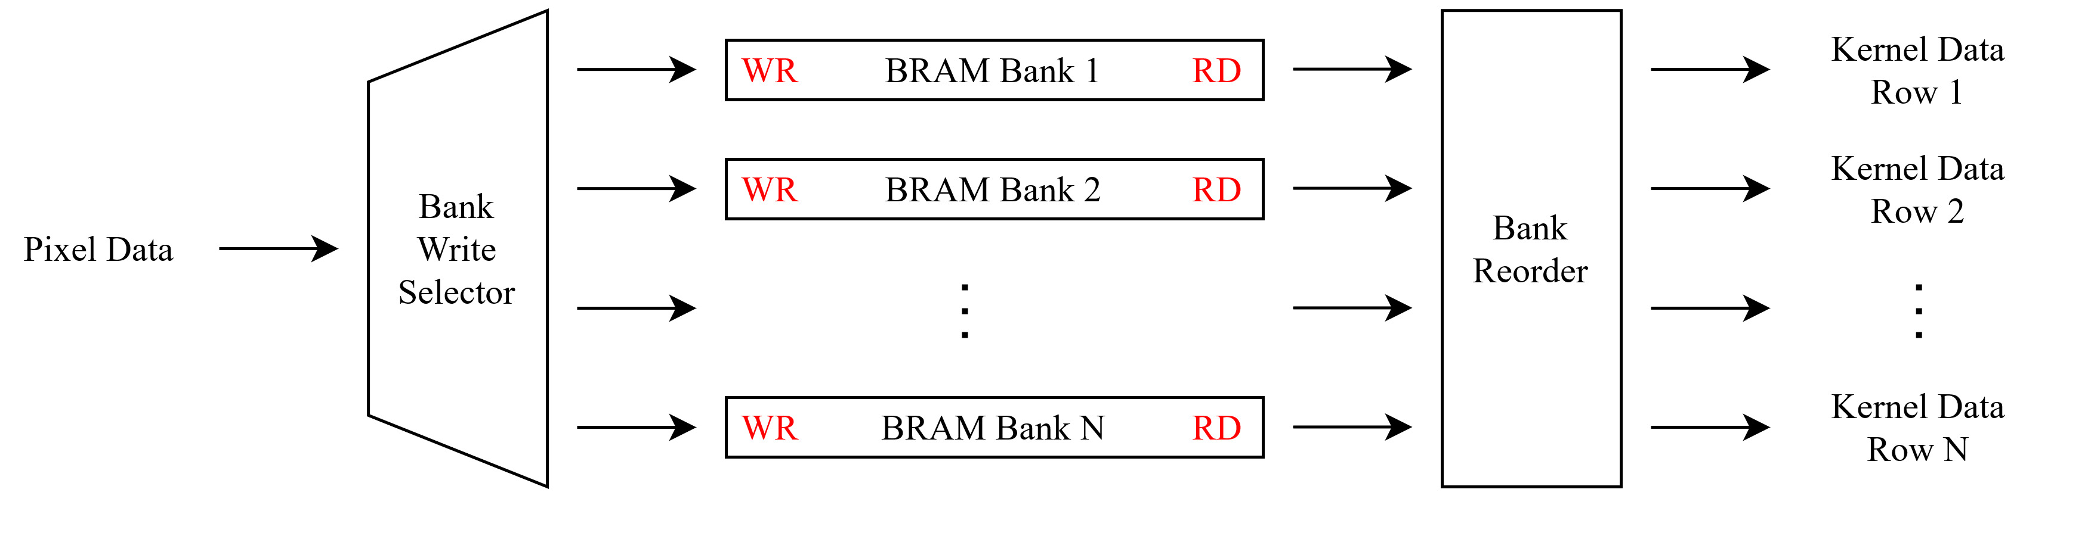
The convolution controller handles the data stream with an internal state machine
For a kernel of size N, the line buffers temporarily store N rows of input map as each convolution requires NxN data points from N rows and N columns
Line buffers are implemented to infer into BRAM as to not waste available device logic
Proposed Convolution Processing Element
13

Slide 15
Partially Reconfigurable Parameters
Data Precision
Not Partially Reconfigurable Parameters
Process Channel Count
Kernel Size
Max BRAM Bank Width
The proposed Convolution Processing Element utilizes DPR at a processing element level
Traditional FPGA methods implement parallel data paths, fully reconfigure, or use DPR at a full pipeline level
Only convolution layer of CNN is implemented/evaluated
Proposed Convolution Processing Element
14

Slide 16
Hardware Implementation & Comparisons
Introduction
Computer Vision
Traditional IoT CNN Models
Hardware Accelerator Types
Reconfigurable Hardware
Dynamic Partial Reconfiguration
Related Work
Proposed Convolution Processing Element
Hardware Implementation & Comparisons
Conclusions
Q&A
15

Slide 17
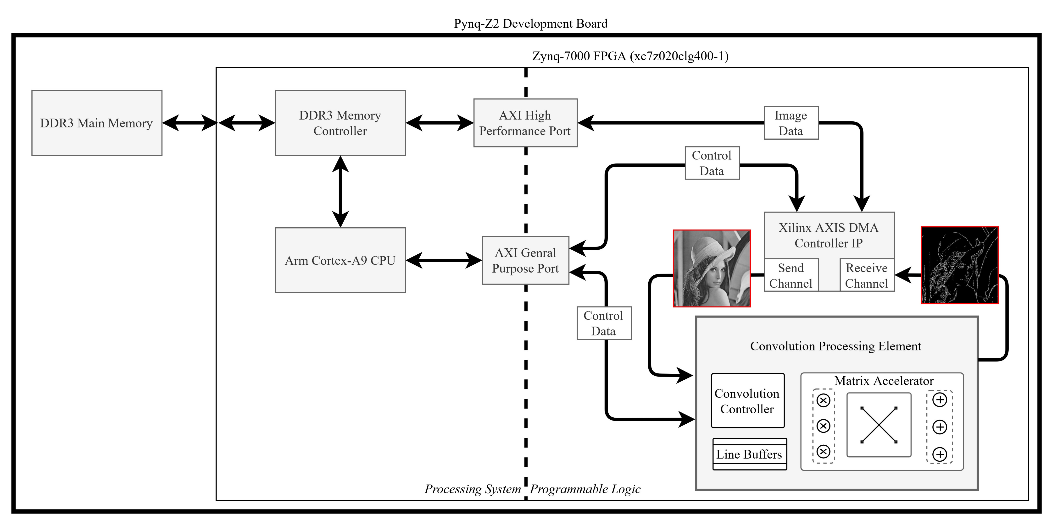
Pynq-Z2 Development Board
 | Hard Config 1 | Hard Config 2
Partially Reconfigurable Parameters
Data Precision | 8-,16-,32-Bit | 8-,16-,32-Bit
Not Partially Reconfigurable Parameters
Process Channel Count | 1 Channels | 3 Channels
Kernel Size | 3x3 | 3x3
Max BRAM Bank Width | 1800 px | 1800 px
Hardware Implementation & Comparisons
16

Slide 18
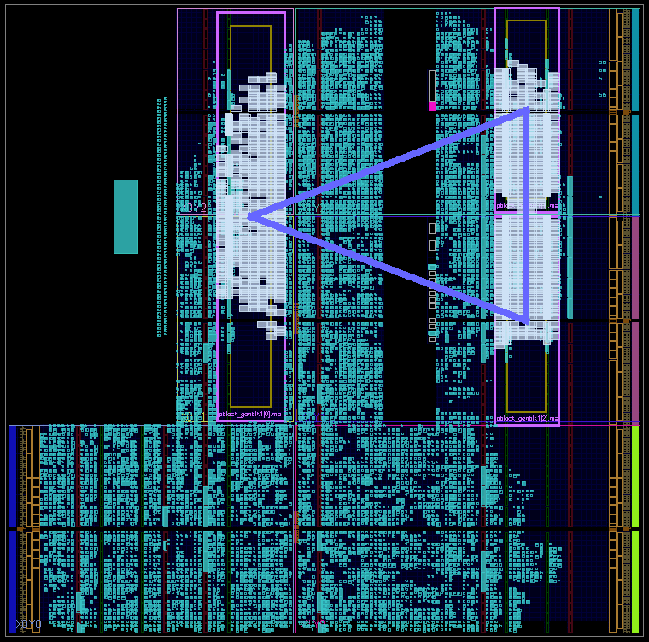
Reconfigurable regions are manually mapped to the FPGA floorplan during Synthesis
If the partition definitions need special elements like DSP, the region must be mapped to include this
3 channel convolution processor with RR mapped to FPGA floorplan
1 channel config has a different floorplan
Reconfigurable Regions
One RR per
Matrix Accelerator
Dynamic Partial Reconfiguration
17

Slide 19
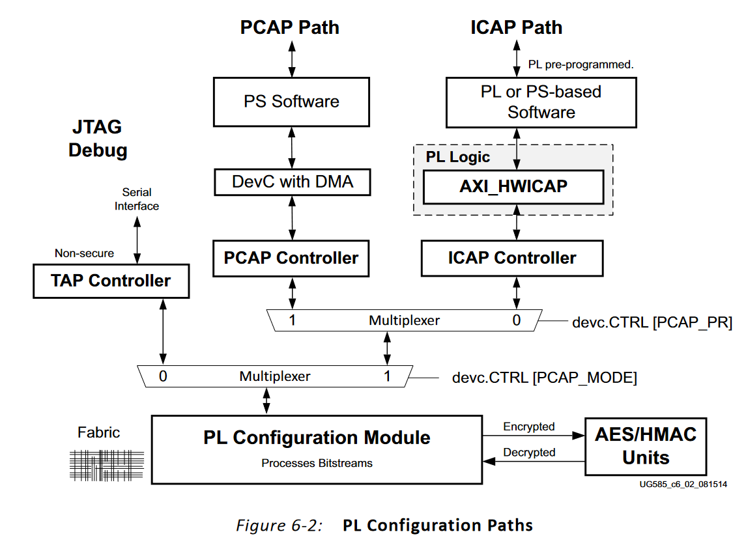
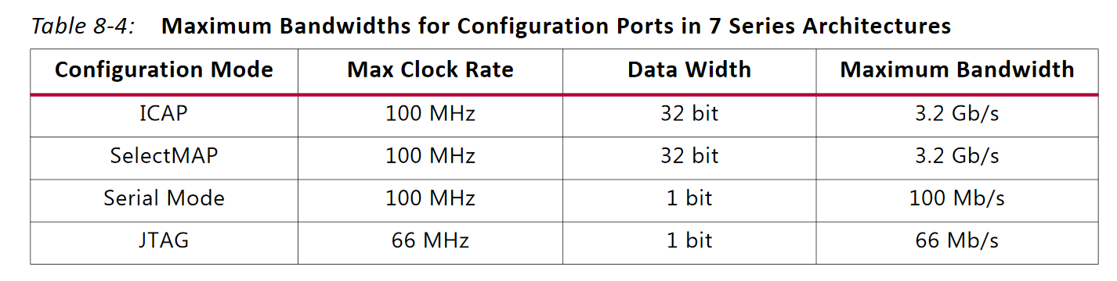
FPGA has several ways to programmed on boot that vary with device family
The Zynq device used in implementation allows programming over Serial, JTAG, ICAP, and PCAP
The port bandwidth varies drastically
Ref: Xilinx UG585 Zynq-7000 SoC Technical Reference Manual
Ref: Xilinx UG909 (v2018.1) Partial Reconfiguration
Dynamic Partial Reconfiguration
18

Slide 20
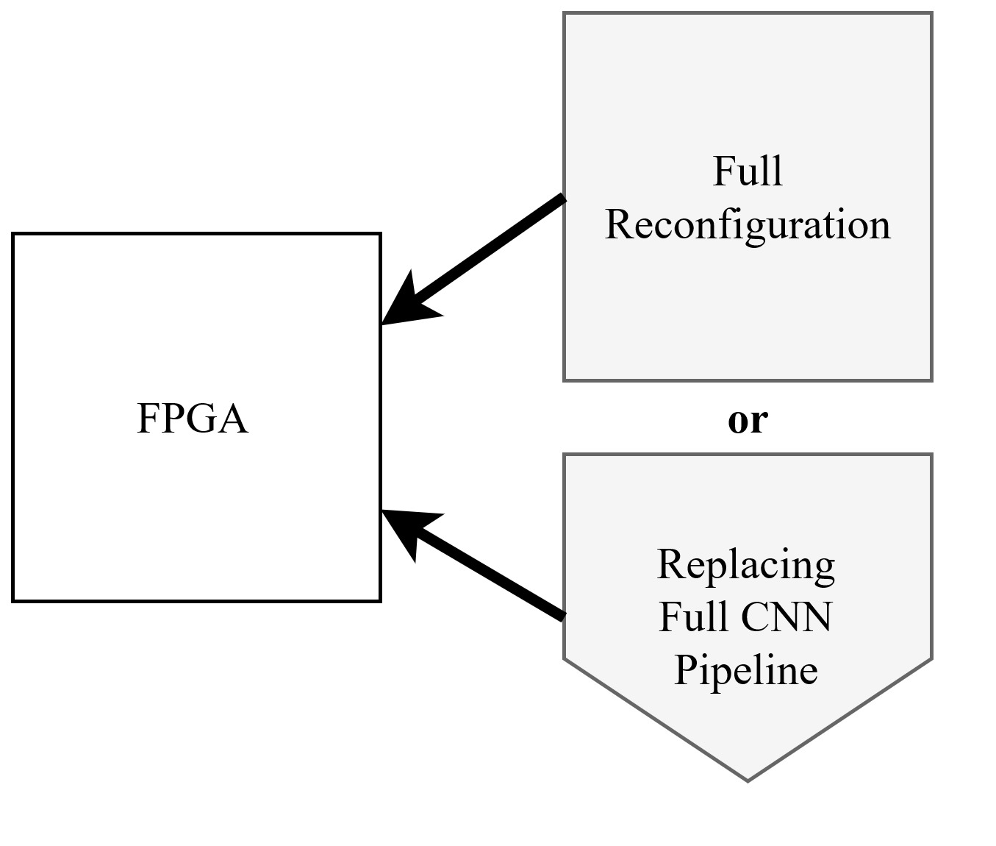
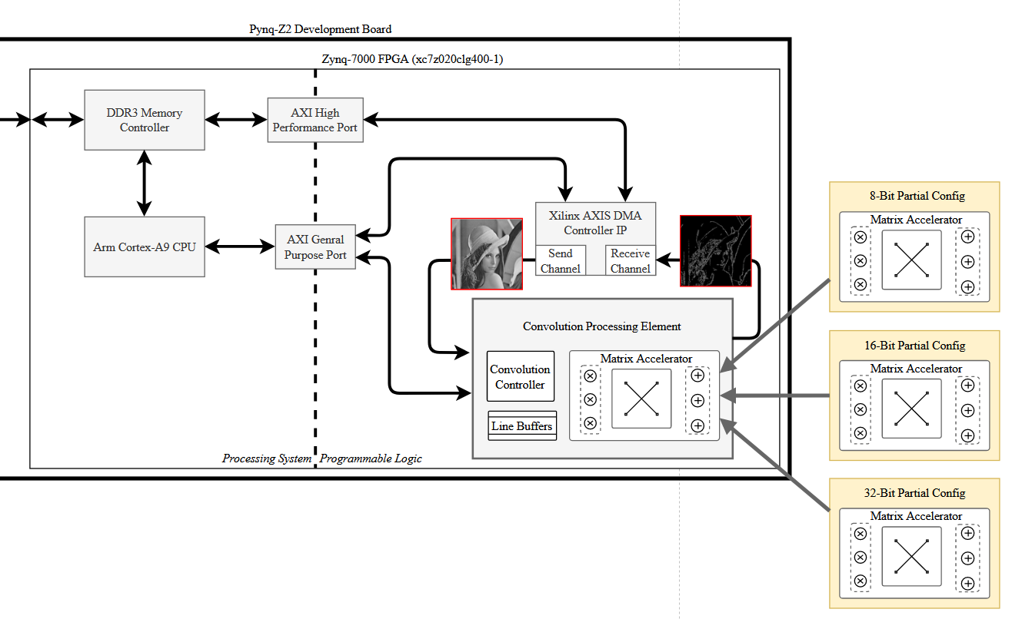
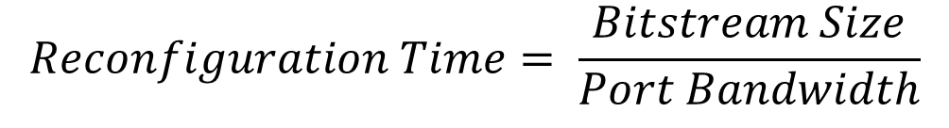
$$Reconfiguration Time= \frac{Bitstream Size}{Port Bandwidth}$$
(Traditional)
Full Reconfiguration
Using JTAG
(Proposed Implementation)
Partial Reconfiguration at processing element level
Using ICAP
Bitstream Size:
32,364,512 b
Port bandwidth:
66 Mb/s
Reconfiguration Time:
490.371 ms
Bitstream Size:
1,766,976 b
Port bandwidth:
3.2 Gb/s
Reconfiguration Time:
0.552 ms
As traditional methods would reconfigure the full device via JTAG,
using DPR at a processing element level reduces configuration time by 800x
Hardware Implementation & Comparisons
19

Slide 21
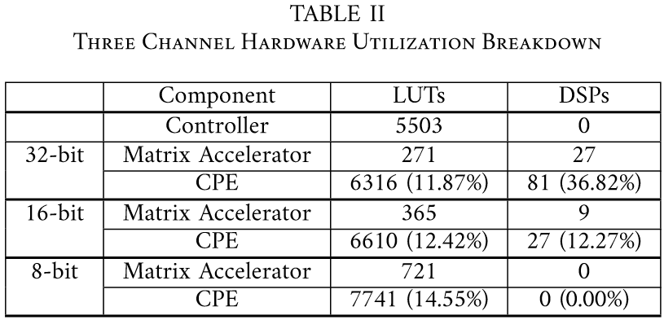
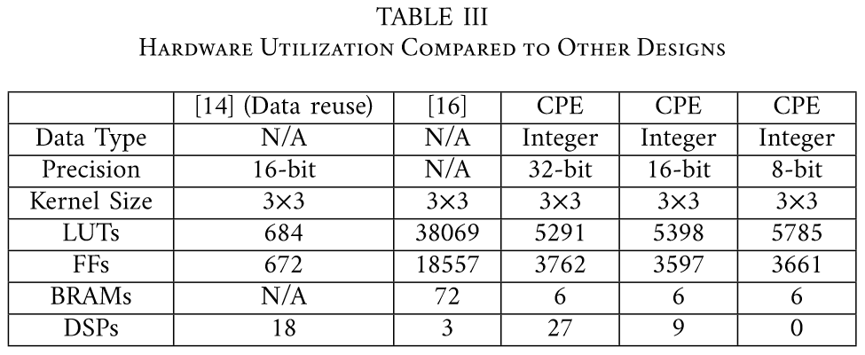
Hard configured for 3 channels in comparison
At 32-bit configuration, DSP utilization reaches 36% of total available on device
This is a limited resource for larger systems so lower precisions should be considered
Rupani et. Al [16] use a design which buffers the full image which causes high BRAM utilization
Hardware Implementation & Comparisons
20

Slide 22
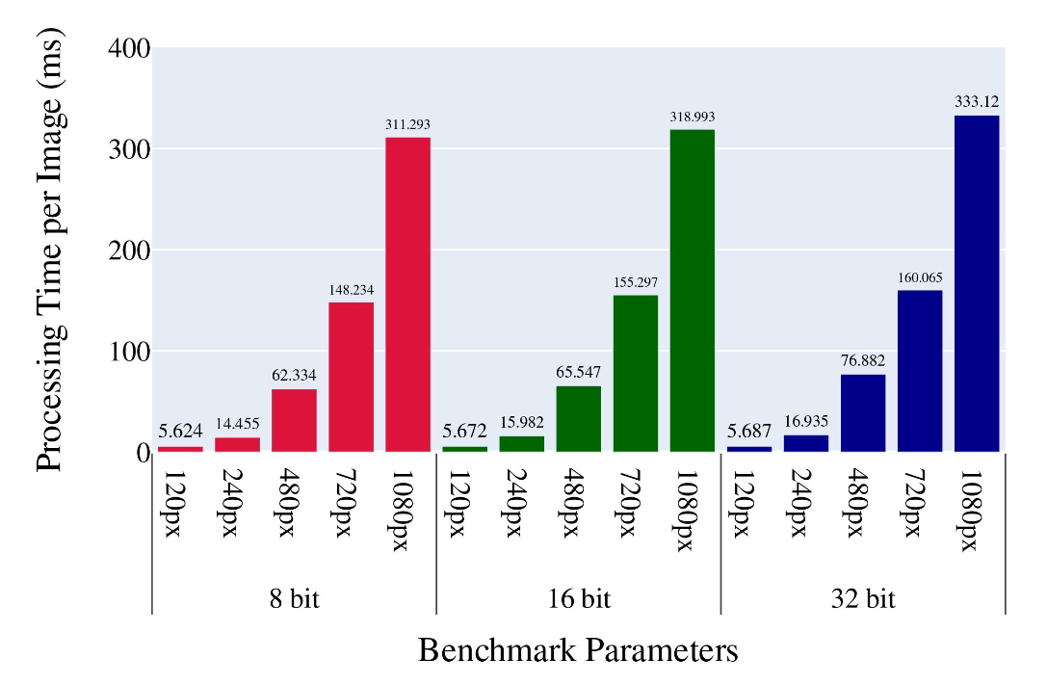
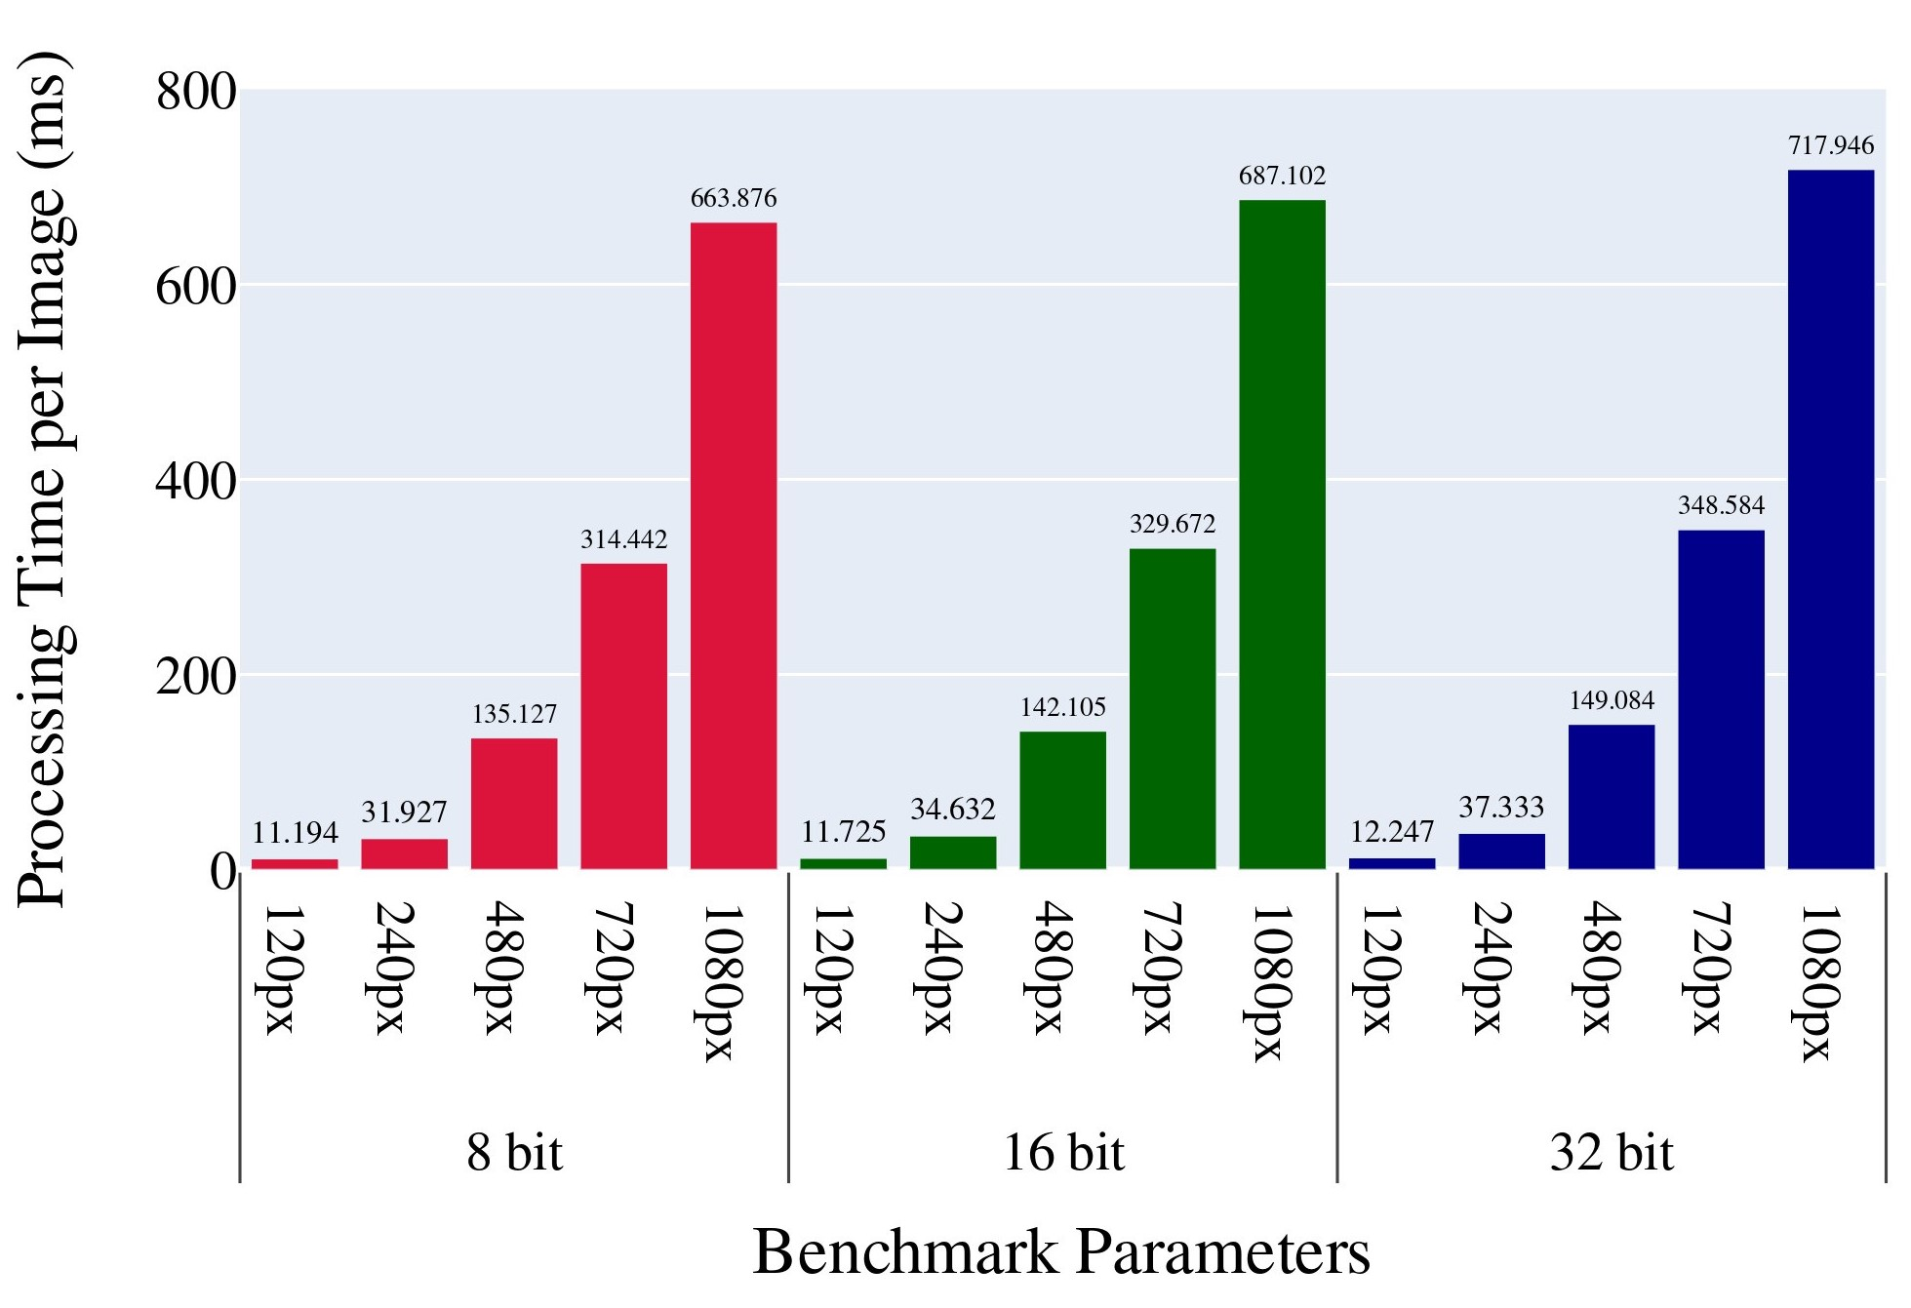
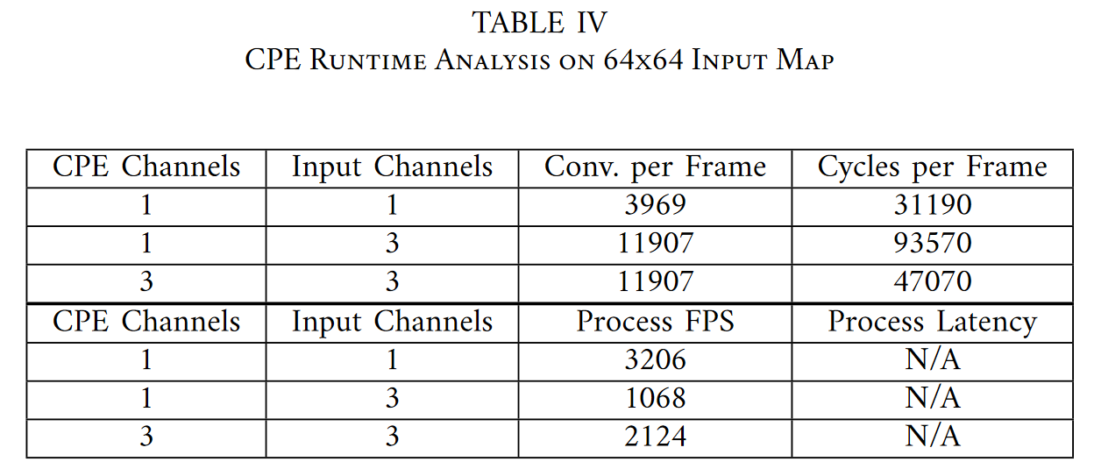
System Operating Frequency: 100 MHz
Single Channel Config (Jupyter Notebooks)
Three Channel Config (Jupyter Notebooks)
Three Channel Config (Vitis)
When testing with Jupyter Notebooks (Left & Middle), reconfiguration was completed using JTAG
Benchmarking was moved to Vitis (Right) which enabled use of the ICAP for reconfiguration
Changing software environments does not affect hard processing capabilities.
Hardware Implementation & Comparisons
21

Slide 23


Contributions
A design architecture which enables system downtime to be minimized if pipelines are strategically queued and reconfigured
A design architecture can be elaborated further to reuse hardware for algorithm changes or process parallelization at lower precision

Slide 24
Conclusions
FPGAs enables resource efficient processors to be developed for application specific needs
FPGAs also offers Dynamic Partial Reconfiguration which greatly suits the computationally constrained systems found in IoT embedded devices

Slide 25






Thank You (Images processed using CPE)

Slide 26

Questions?

